Slide 1



Project Title
MOVIE TICKET BOOKING SYSTEM
PRESENT BY:
Vijita Mohanraaj
22BAI1452

Slide 2
Objective
Movie Ticket Booking System is to manage the details of Shows, Booking, Payment, Movie and Customer. It manages all the information about Shows, Seats, and Customers.
The purpose of the project is to build an application program to reduce the manual work for managing the Shows, Booking, Seats and Payment.

Slide 3

Entities And Attributes
ADMIN
admin_id | password
CUSTOMER
c_name | phone_no | cid | email_id | password
TICKET
t_no | audi_no | tid | price | seat_id | show_id | show_date | admin_id
MOVIE
m_name | ratings | duration

Slide 4
Entities And Attributes
SHOW
show_time | m_name | language | show_date
SEATS
seat_id | s_name | no_seats
PAYMENT
t_amount | pay_id
THEATER
tid | thname | location

Slide 5
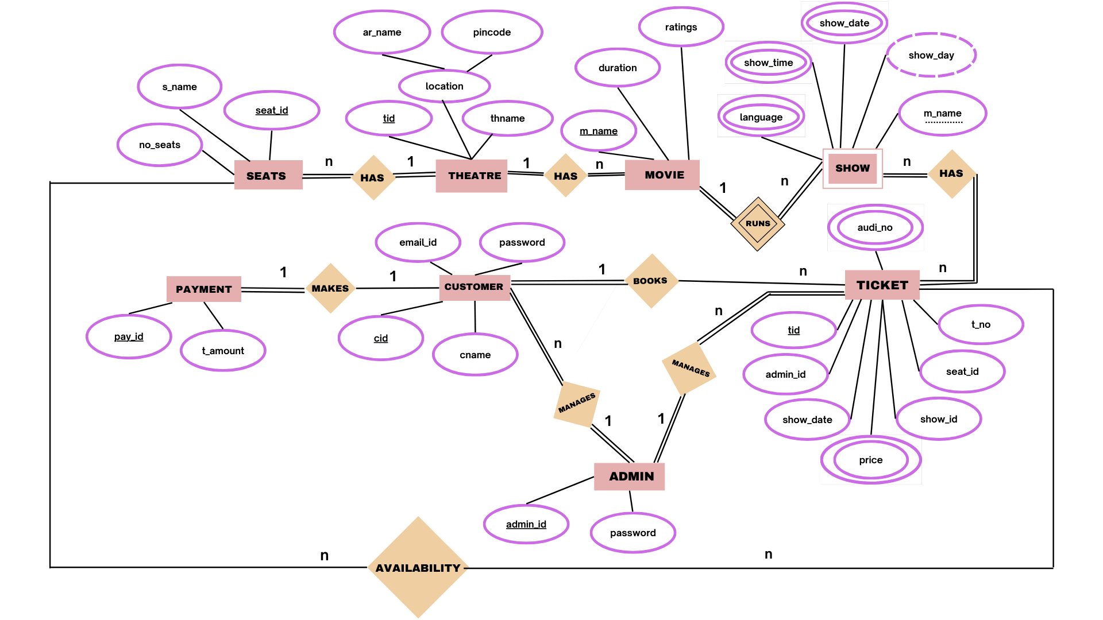
ER DIAGRAM

